Slide 1
Building AI-Powered
PR Reviewer
Local LLM - Gemma3 - NodeJs
Vamshi

Slide 2

Intro
SDE 3 at Tesco (Ex - Intuit, CommonFloor)
ML, Kubernetes certified
Speaker (React Nexus, React Bangalore)
Opensourced GraphQL mocking library "apollo-mock-http"
IITM & IITB Alumni
YouTube▶️ @codegully_channel

Slide 3
Agenda
Local LLMs intro - benefits, limitations
Working with Local LLMs - intro + demo
Strategy
DEMO
Q/A

Slide 4
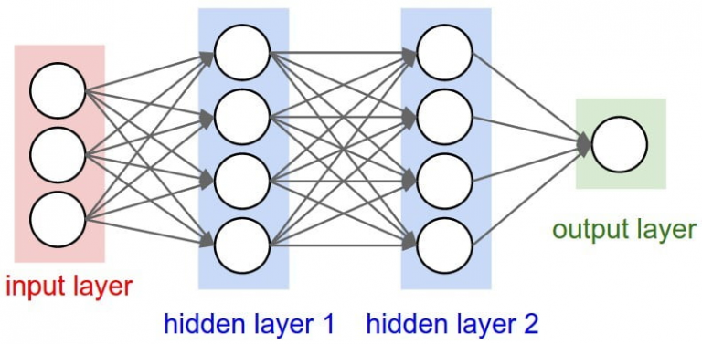
Local LLMs
Quantized models
Weights compresssed
Inference only - no further training*
Limitation (Learned model) - use with more context
Local - Privacy, Offline, Latency*
Context window limitations
source: https://www.bmc.com/blogs/deep-neural-network/

Slide 5
Working with local LLMs
Ollama
CLI based - like package manager - for LLMs
Server capabilities
LM Studio
GUI based
Out of the box tools (chat, model management, Headless mode, settings etc.)

Slide 6
Strategy
Code Repo
Load & Cache in server
File diff
Split and figure out files changed
Changed file - compare with main
New file - compare with similar files
Call LLM with file and their particular diff

Slide 7
PR Reviewer flow
Nodejs Server
Code Repo + Patchfile
Strategy
overcome Context Window limitations
LM Studio
Exposing LLM to services
Gemma3
LLM 🧠

Slide 8
DEMO

Slide 9
Strategy limitations
Limitation on LLM
Coder specific LLM
Fine tune for tech
Holistic review
Cross file usages on changes
Binaries

Slide 10
Take aways!
Local LLMs
Ollama, LMStudio
Strategies - to overcome limitations
https://github.com/vamshisuram/reviewer

Slide 11


Thanks
Prem & AI XCHANGE team
Google for Developers
Questions ?
Connect
in/vamshisuram

